Slide 1
Vidyo Certified Deployment and Support Engineer Training – Day Two v3.x.x
Many of the products and features described herein remain in varying stages of development and will be offered on a when-and-if available basis. The product plans, specifications, and descriptions are provided for information only and are subject to change without notice, and are provided without warranty of any kind, express or implied. Vidyo reserves the right to modify future product plans at any time.

Slide 2

Day 2 - Agenda
Topic | Lab Exercise | Time
Day One Review Exercise |  | 9:00 – 10:00 AM
VidyoRoom System Setup/Usage |  | 10:00 – 11:00 AM
Break |  | 11:00 – 11:15 AM
VidyoReplay Setup/Usage |  | 11:15 AM – 12:30 PM
Lunch |  | 12:30 – 1:15 PM
VidyoGateway Setup/Usage |  | 1:15 – 2:30 PM
Break |  | 2:30 – 2:45 PM
Day Two Review Exercise |  | 3:15 – 5:00 PM

Slide 3
Day 2 - Training Objectives
List and describe the available VidyoRoom system models/revisions
Set up a VidyoRoom system
List and describe the supported VidyoRoom system cameras
Join or Host a video conference with a VidyoRoom system
Use the VidyoRemote to conduct in and out of conference functions
Remotely administer a VidyoRoom system
Restore a VidyoRoom to its default state

Slide 4
VidyoRoom System Setup

Slide 5
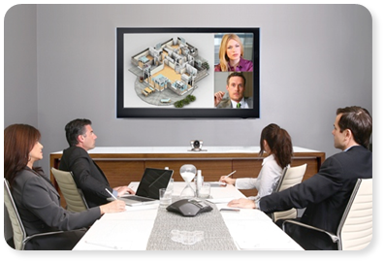

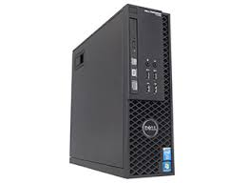
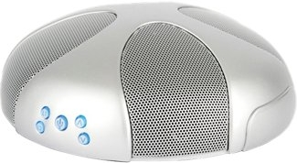
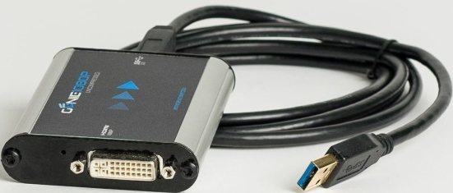
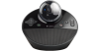
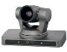
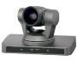
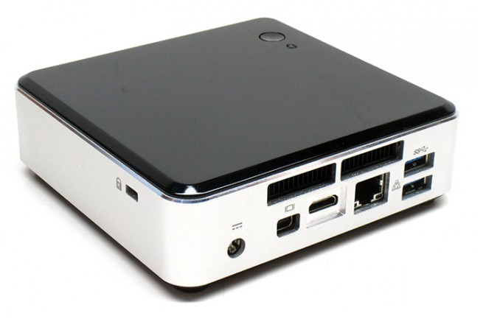
VidyoRoom - 3.0 Portfolio
 | HD-230 | HD-100D | HD-40B
HD Encoding | 1080p30 | 720p30 | 720p30
HD Decoding | 1080p60 x Dual Screen | 1080p30 | 1080p30
Display 1 | Content and/or Up to 16 participants | Content and/or Up 8 participants | Content and/or Up 8 participants
Display 2 (optional) | Content and/or Up to 16 participants | Content Only | Content Only
Remote Content Sharing | 1080p30 (native) | 720p30 (requires Pro Pack) | 720p5 (requires Pro Pack)

Slide 6
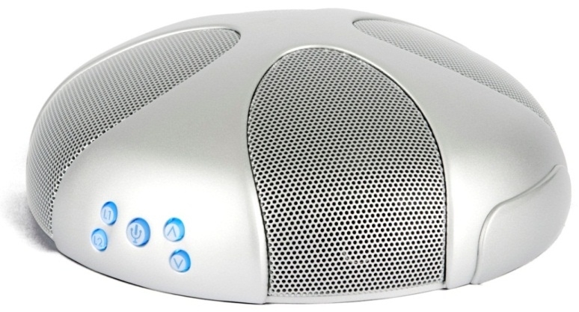
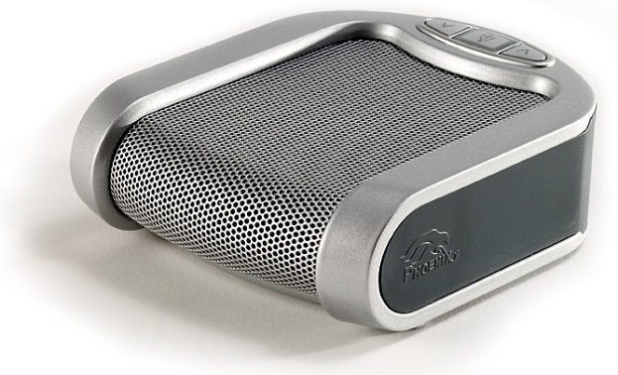
VidyoRoom - Speakerphone Options
Phoenix Duet
PCS
Phoenix Quattro
Q3-MT304

Slide 7
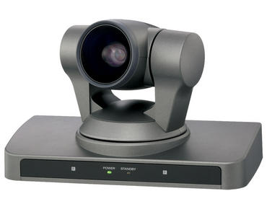
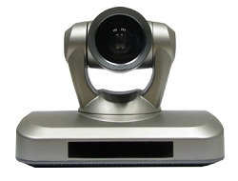
VidyoRoom - Camera Options
Sony EVI-HD7V
1080p60
VISCA Cable (1) for local and FECC
DVI Interface
Minrray VHD-A910
1080p30
VISCA Cable (1) for local and FECC
HDMI Interface

Slide 8
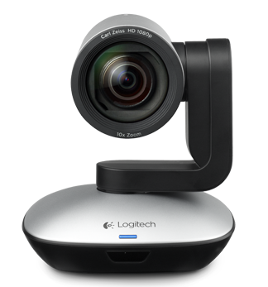
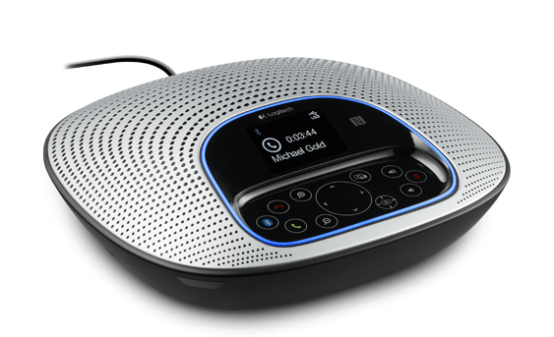
VidyoRoom – Speakerphone Camera Combo
Logitech ConferenceCam CC3000e
1080p30
USB interface

Slide 9
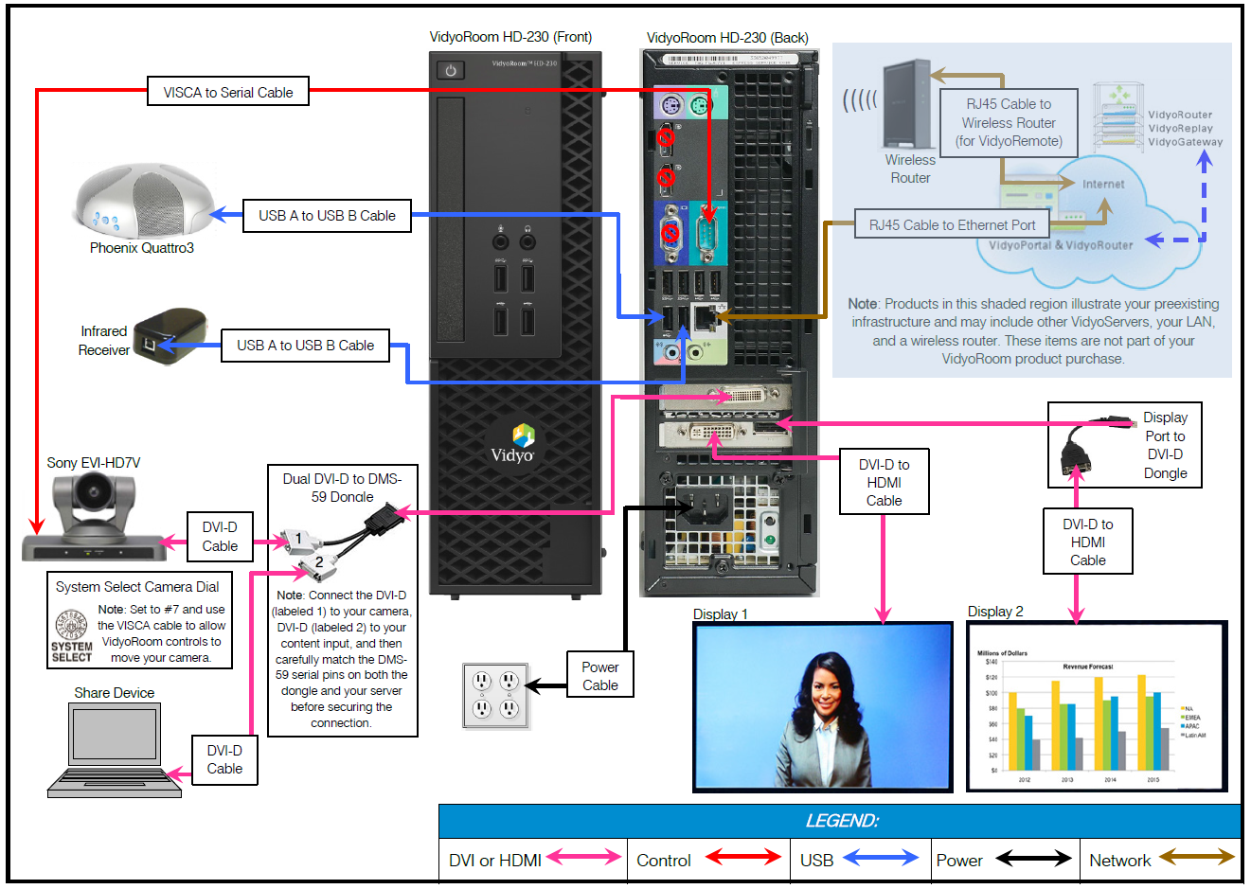
VidyoRoom – HD-230 System Diagram w/ Sony EVI-HD7V DVI Camera

Slide 10
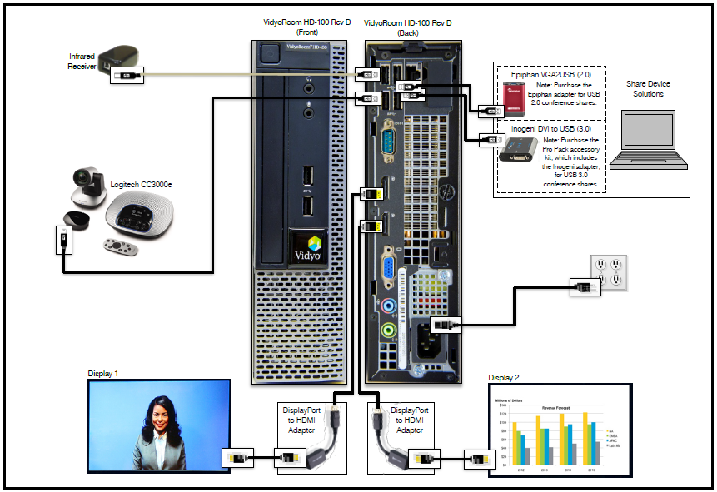
VidyoRoom – HD-100D System Diagram w/ Logitech cc3000e USB Camera

Slide 11
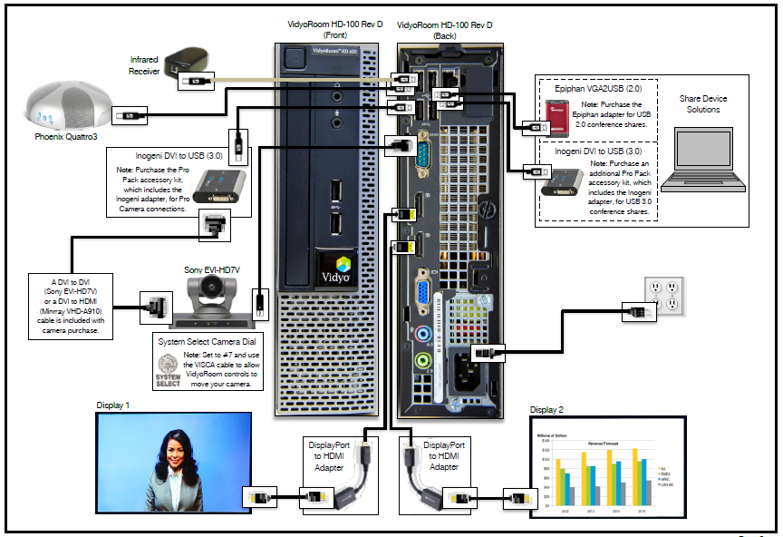
VidyoRoom – HD-100D System Diagram w/ Sony EVI-HD7V DVI Camera

Slide 12
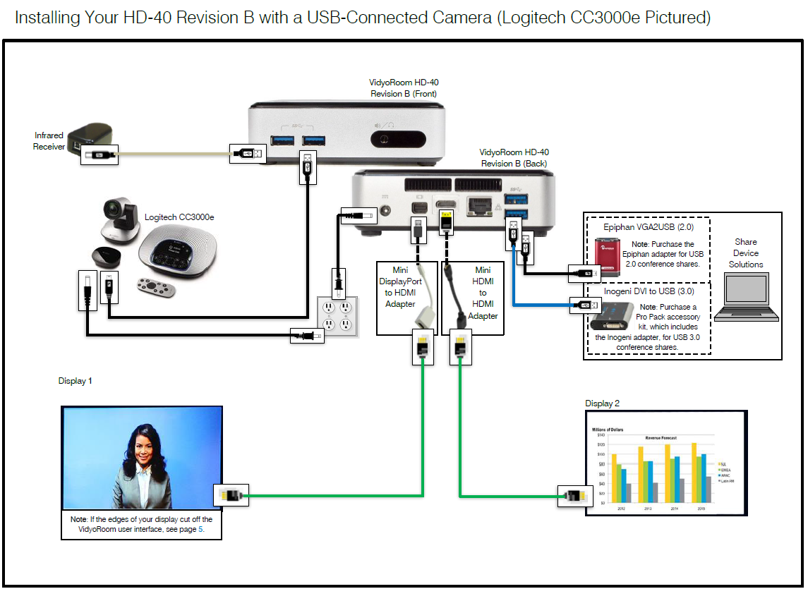
VidyoRoom – HD-40B System Diagram w/ Logitech cc3000e USB Camera

Slide 13
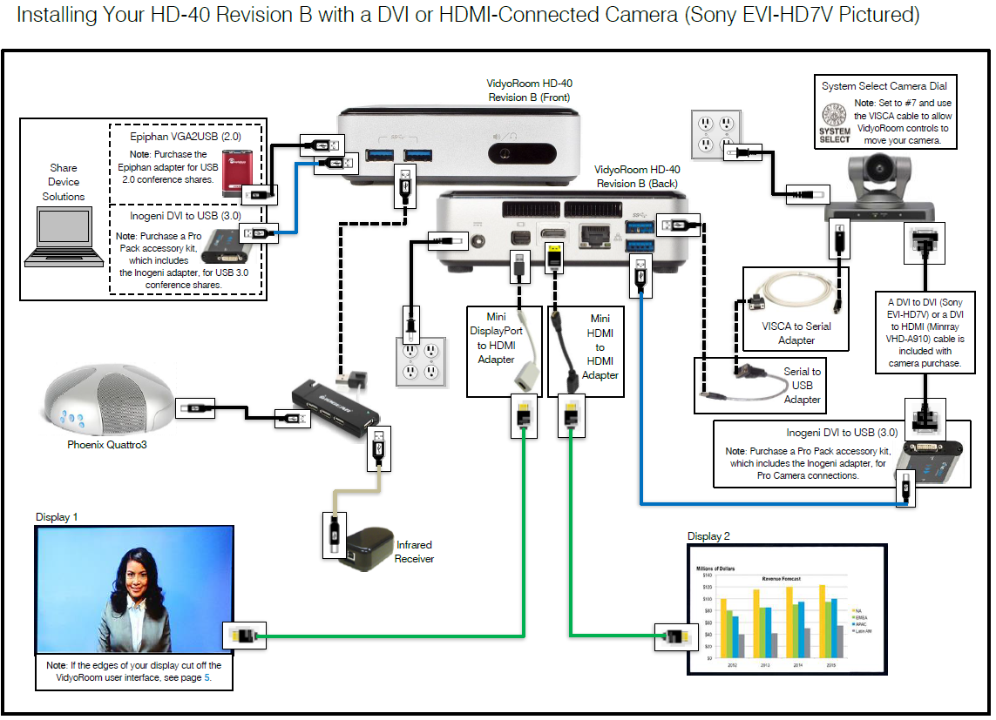
VidyoRoom – HD-40B System Diagram w/ Logitech cc3000e USB Camera

Slide 14

Trainer Demo
During this demo, the trainer will demonstrate the following:
Connecting Accessories
Camera
USB Speakerphone
Displays
Power On System
Configure Credentials and Sign In
Configure System Settings
Conduct a Test Call
Join a video conference with a VidyoRoom system
CHECK THIS OUT!

Slide 15

VidyoRoom - Common Setup Pitfalls
VISCA In port must be used for camera control on Sony models
USB end of the VISCA to USB cable for Camera Control must be connected to the correct Camera Control port labelled in provided diagrams.
Sony models must have the ‘System Select’ option set to the correct resolution and frame rate (reference table located on the bottom of the camera)
Make sure that you use a ‘VidyoRoom’ account type for VidyoRoom systems

Slide 16
Using a VidyoRoom System

Slide 17
VidyoRoom – Initial Setup
Ensure that the speaker/microphone is on the table
Note: position it in the middle so everyone in the room can speak and hear
Turn on the Vidyo camera
Note: the switch is on the back left-hand side
Turn on the TV
Turn on the VidyoRoom system
Note: the button will turn blue
The system will begin to boot up
Note: you will see the VidyoRoom logo and then the VidyoPortal home page

Slide 18
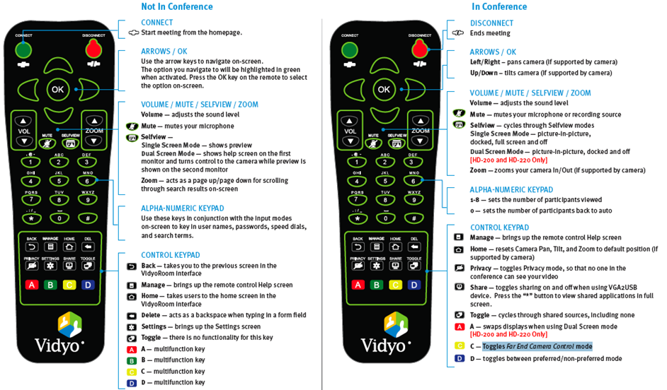
VidyoRoom - Using the Remote Control
Notes:
Note to trainer: You will now walk through all the features that apply to using the remote in the VidyoDesktop

Slide 19
Trainer Demo
During this demo, the trainer will demonstrate the following:
Reimaging a VidyoRoom system
CHECK THIS OUT!

Slide 20

VidyoRoom - System Setup and Usage Finish Line
Congratulations! You should now be able to:
List and describe the available VidyoRoom system models/revisions
Set up a VidyoRoom system
List and describe the supported VidyoRoom system cameras
Join or Host a video conference with a VidyoRoom system
Use the VidyoRemote to conduct in and out of conference functions
Remotely administer a VidyoRoom system
Reimage a VidyoRoom system

Slide 21
VidyoPortal - Reference Materials
Topic | Document Name | Page(s)
Admin and General Usage | VidyoRoom User’s Guide | All

Slide 22
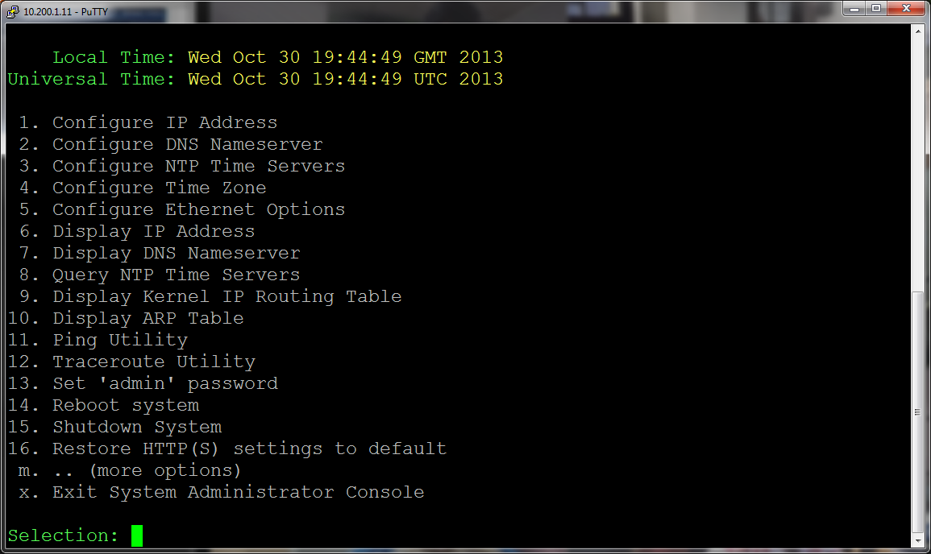
VidyoReplay Setup and Usage

Slide 23
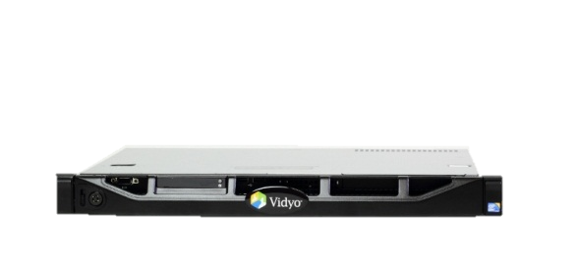
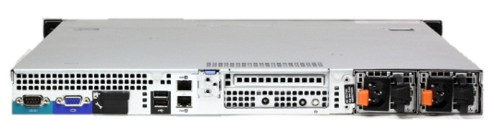
VidyoReplay - Specifications
1U Dell 410 chassis
Redundant Power Supply
Recording Capacity
5 x HD-720P30 @ 1 Mbps
15 x 4CIF (SD) @ 512 Kbps
25 x CIF @ 384 kbps
50 x voice
Playback and storage capacity
5 Concurrent recordings
300 Concurrent views (VOD and Webcasting)
2500 hours of HD content
Per tenant recording lock, filtering, and cleanup (mass deletion)

Slide 24
VidyoReplay Initial Setup - Lab Exercise #10
Use the provided lab exercise document to complete the
following objectives:
SSH to the VidyoReplay
Configure your VidyoReplay with your assigned IPN / DNS settings (refer to exercise sheet)

Slide 25
VidyoReplay - Setup
Create VidyoReplay components on the VidyoPortal
Add VidyoReplay URL and components to tenant
Allow group access to the VidyoReplay
Configure VidyoReplay via its web UI (e.g. replayx.vidyotraining.com)
VidyoReplay (point to a valid tenant URL and input credentials)
VidyoReplay Recorder (point to a valid tenant URL and input credentials)
Name VidyoReplay components (2) via the VidyoPortal’s Super Admin interface
Test configuration
Join your room and record
Access the VidyoReplay Library and play the recorded conference.

Slide 26
Trainer Demo
During this demo, the trainer will demonstrate the following:
Completing the VidyoReplay setup
CHECK THIS OUT!

Slide 27
VidyoReplay Setup - Lab Exercise #11
Use the provided lab exercise document to complete the following
objectives:
Configure the VidyoReplay for use
Assign the VidyoReplay to your primary tenant (e.g. teamx.vidyotraining.com)
Allow your primary tenant, to use the VidyoReplay
Edit the recording
Change the name of the recording to ‘Training Exercise Recording’
Assign the following PIN code to the recorded video: 4321
Email a link of the recording to yourself
Launch the ‘Training Exercise Recording’ via the email link

Slide 28
VidyoGateway Setup and Use

Slide 29
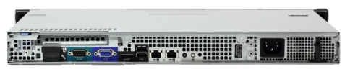
VidyoGateway Models - Specifications
Appliance rack-mountable 1U servers connecting legacy SIP & H.323 equipment to the Vidyo network
VidyoGateway - Dell 210 chassis
Capacity
1 x HD-720P30 @ 1 Mbps
4 x 4CIF (SD) @ 512 Kbps
12 x CIF @384
50 x voice
VidyoGateway XL - Dell 410 chassis
Capacity
5 x HD-720P30 @ 1 Mbps
15 x 4CIF (SD) @ 512 Kbps
25 x CIF @ 384 kbps
50 x voice

Slide 30
VidyoGateway Initial Setup - Lab Exercise #12
Use the provided lab exercise document to complete the following objectives:
SSH to the VidyoGateway
Configure your VidyoGateway with your assigned IPN / DNS settings (refer to exercise sheet)

Slide 31
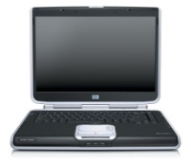
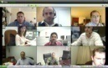
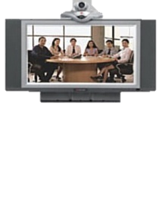
VidyoGateway – Connecting One Legacy System
Multiple Vidyo users participating on a conference with a single legacy device
Legacy
H.323/SIP
Endpoint
Vidyo
Desktop
Endpoints
VidyoGateway™
VidyoRouter™
AVC
SVC

Slide 32
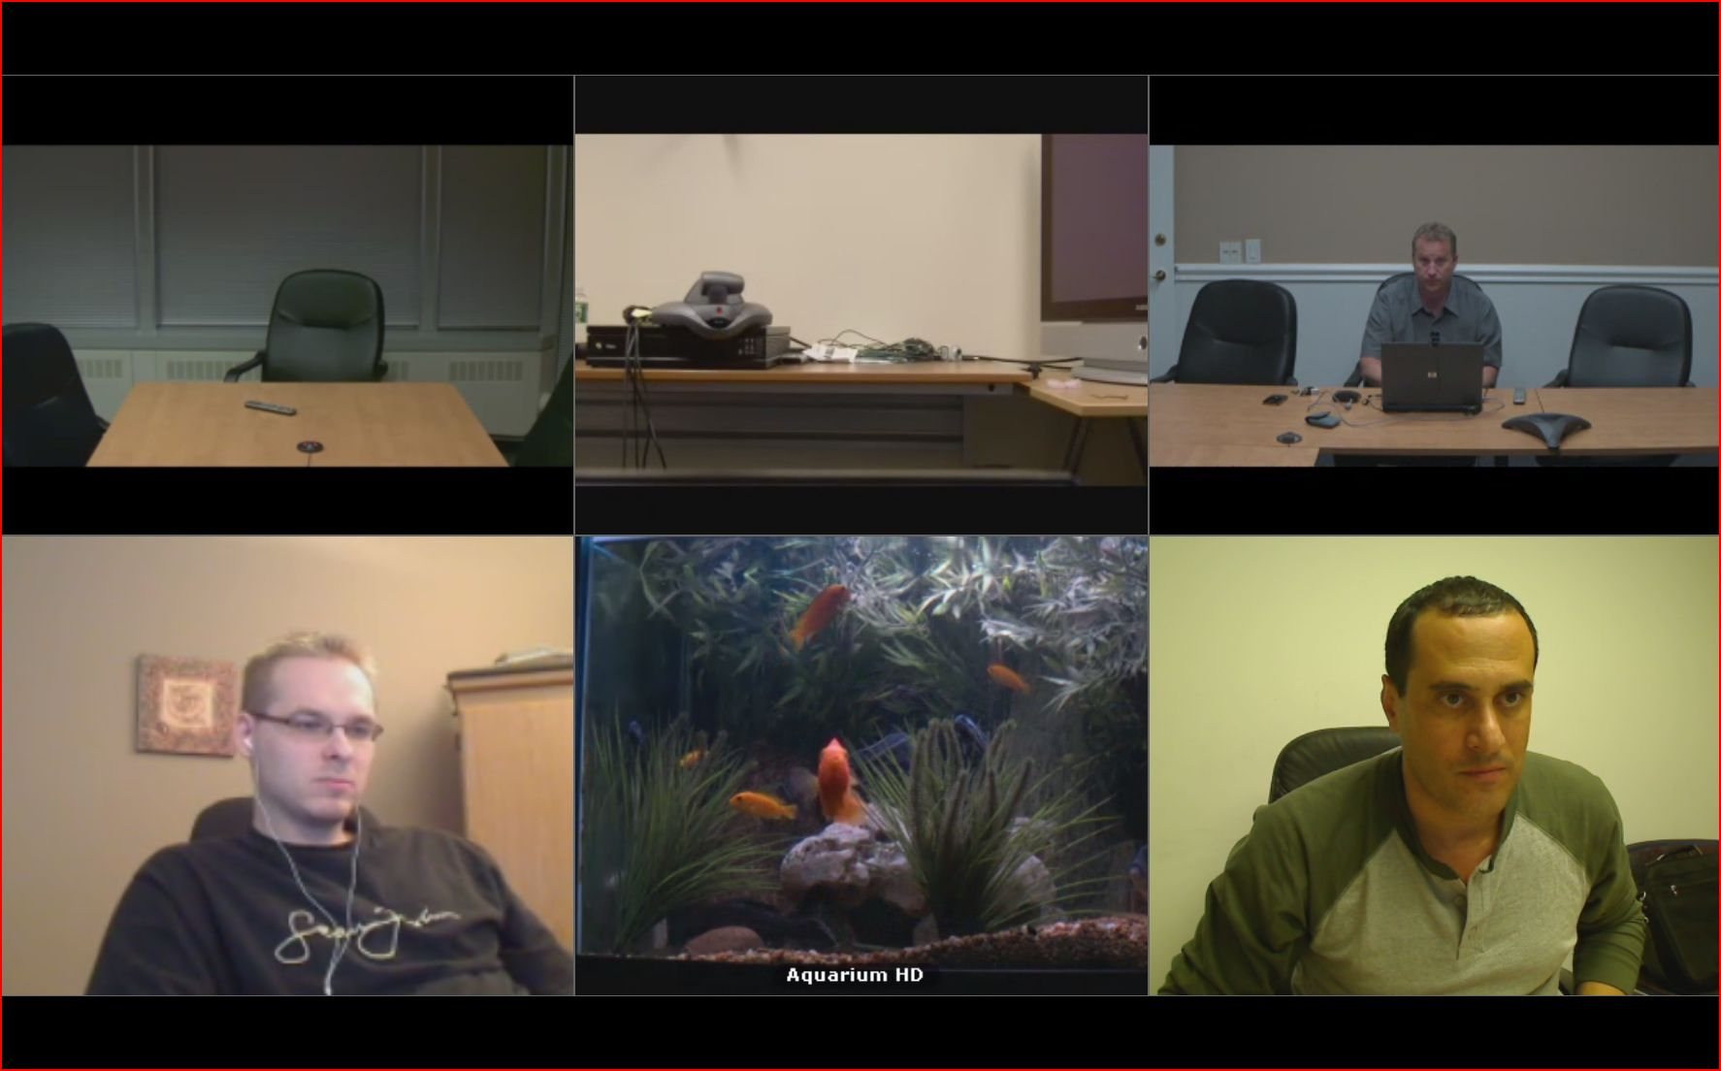
VidyoGateway – Connecting One Legacy System

Slide 33
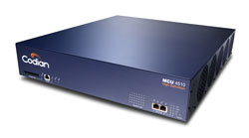
VidyoGateway – Connecting Legacy Systems with MCU
A Few Vidyo end users connected to a few legacy endpoints using a legacy MCU
Legacy
H.323/SIP
Endpoints
Vidyo
Desktop
Endpoints
VidyoGateway™
VidyoRouter™
Legacy MCU
AVC
SVC

Slide 34
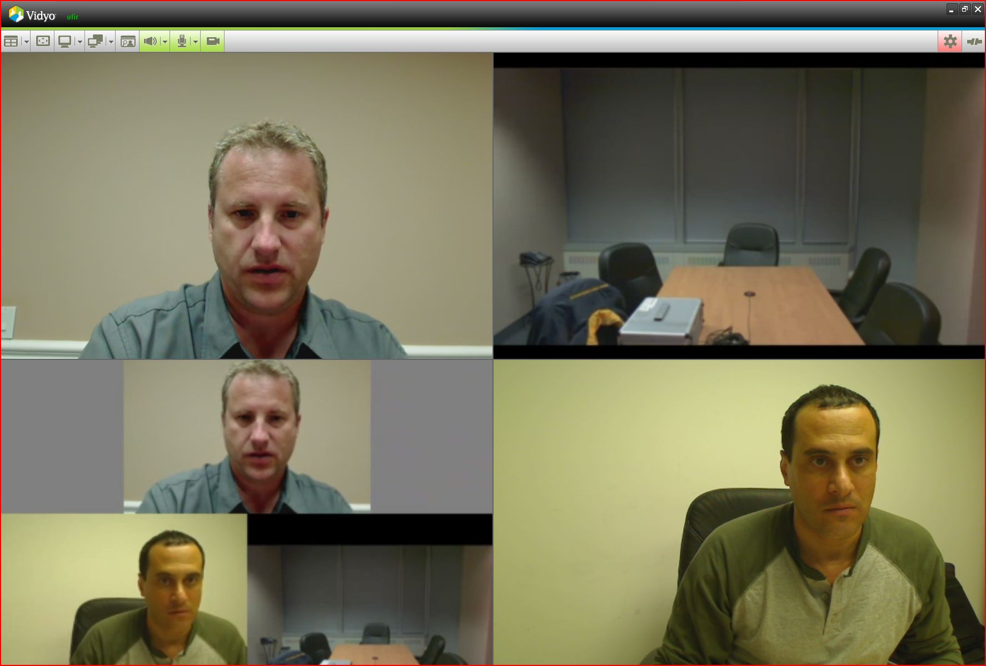
VidyoGateway – Connecting Legacy Systems with MCU
To insure a quality experience
Legacy MCU should not be used !

Slide 35
VidyoGateway – Connecting Many Legacy Systems
Three Vidyo users connected to three legacy endpoints using the VidyoGateway
Legacy
H.323/SIP
Endpoints
Vidyo
Desktop
Endpoints
VidyoGateway™
VidyoRouter™
AVC
SVC

Slide 36
VidyoGateway – Connecting Many Legacy Systems

Slide 37
VidyoGateway - Inbound H.323 or SIP using IVR
IP of VidyoGateway
IVR
Room
123.123.123.123
1234
Legacy H.323/SIP Endpoint
VidyoPortal
VidyoRouter
VidyoDesktop
Endpoint
VidyoGateway
AVC
SVC

Slide 38
VidyoGateway - H.323/SIP with Gatekeeper
Prefix
-
Room
Number
Room
Number
Room
Number
H.323/SIP Gatekeeper
1234
VidyoGateway
VidyoPortal
VidyoRouter
(8)1234
1234
Legacy H.323/SIP Endpoint
VidyoDesktop
Endpoint
AVC
SVC

Slide 39
VidyoGateway - H.323/SIP/URI Dialing
IP of VidyoGateway - Delimiter – Room Number
Room Number @ domain / IP
Room
Number
123.123.123.123##1234
1234@mydomain.com
VidyoGateway
VidyoPortal
VidyoRouter
1234
Legacy H.323/SIP Endpoint
VidyoDesktop
Endpoint
AVC
SVC

Slide 40
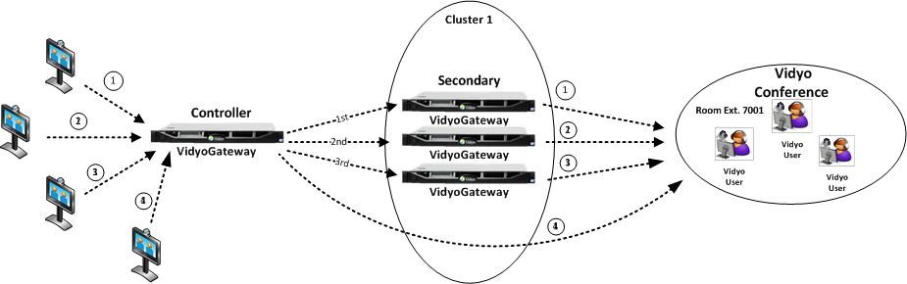
VidyoGateway – One VidyoGateway Cluster
Active Controller will load balance across the clustered gateways.

Slide 41
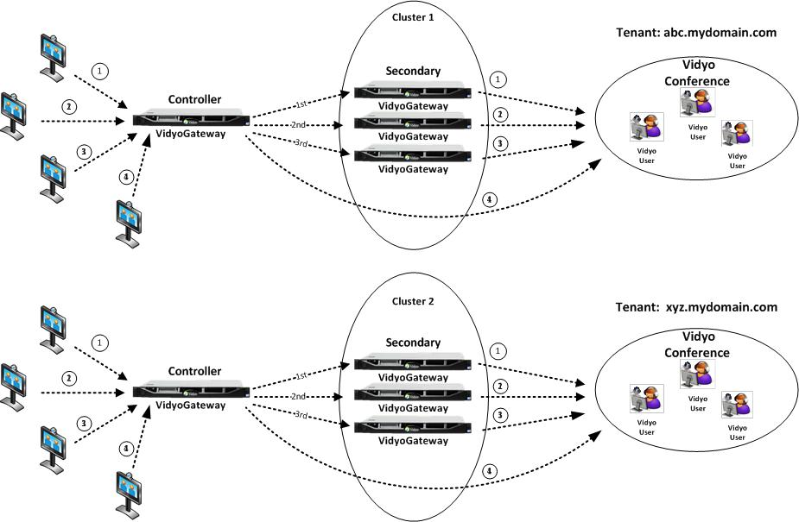
VidyoGateway – Multiple VidyoGateway Clusters

Slide 42
VidyoGateway - Trainer Demo
During this demo, the trainer will demonstrate the following:
Completing the VidyoGateway Setup
Conducting a test call to a legacy device
CHECK THIS OUT!

Slide 43
VidyoGateway Setup - Lab Exercise #13
Use the provided lab exercise document to complete the
following objectives:
Configure the VidyoGateway for use
Connect to a Legacy device (e.g. fishtank.lifesize.com)

Slide 44
VidyoGateway - Administration Reference Materials
Topic | Document Name | Page(s)
General | VidyoGateway Admin Guide | All
Dial String Examples | Dialing Summary Tables | All

Slide 45
Day Two Review - Lab Exercise #15
Use the provided lab exercise document(s) to complete this exercise.
Setup the VidyoPortal, VidyoRouter, VidyoGateway and VidyoReplay
Join your room and record/playback
Connect to a legacy device

Slide 46
Day Two Finish Line
Congratulations! You should now be able to:
Setup and use the following:
VidyoRoom
VidyoReplay
VidyoGateway

Slide 47
Thank you!

